Slide 1




GRADE 9-10 · AP PRECALCULUS · UNIT 1
Topic 1.12
Transformations
of Functions
Journey of 6 stations, 60 minutes
Polynomial and Rational Functions
Mr Malek Thiab
FAITH, RIGHTEOUSNESS AND WISDOM
Notes:
Speaker notes: Welcome to Topic 1.12: Transformations of Functions.
Timing: 60 minutes (Diagnose 6, Targeted Instruction 18, Practice 12, Production 12, Mastery Gate 6, Smart Production 6). For a 40-minute class scale every station by two thirds.
The journey map on the next slide shows the six stations; in slideshow mode the Morph transition zooms the station circles into the breadcrumb at the top of every later slide.

Slide 2


Today's journey
Six stations. Each one zooms in as we arrive.
Targeted Instruction
18 min
Production
12 min
Smart Production
6 min
2
4
6
1
3
5
Diagnose
6 min
Practice
12 min
Mastery Gate
6 min
FAITH, RIGHTEOUSNESS AND WISDOM
Notes:
Speaker notes: This is the whole map. Walk it left to right: Diagnose (what we already know), Targeted Instruction (Additive transformations: translations; Multiplicative transformations: dilations; Combined transformations, domain and range), Practice (Practice, Apply, Investigate), Production (the arch of a footbridge), Mastery Gate (three questions to pass), Smart Production (create, then Time to Check).
In slideshow mode the Morph transition animates these circles shrinking into the breadcrumb on later slides; without Morph the slides fade.
Ask the class which station they think will be hardest.

Slide 3
What we are learning
OBJECTIVES
VOCABULARY
Construct a function that is an additive and/or multiplicative transformation of another function.
additive transformation
multiplicative transformation
vertical translation
horizontal translation
dilation
reflection
preimage
image
parent function
STANDARDS
LO 1.12.A Construct a function that is an additive and/or multiplicative transformation of another function.
LO 1.12.A
FAITH, RIGHTEOUSNESS AND WISDOM
Mr Malek Thiab · 3
Notes:
Speaker notes: Read the objectives aloud one at a time and have students say which one they feel least sure about.
Vocabulary used today: additive transformation, multiplicative transformation, vertical translation, horizontal translation, dilation, reflection, preimage, image, parent function.
Standards are listed on this slide.
The essential question and mathematical practices are not shown because they are not in the project documents; add them from the curriculum map if you want them displayed.

Slide 4
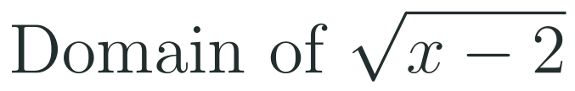
1
2
3
4
5
6
STATION 1 · DIAGNOSE · 6 MIN
Start here: three quick checks
1
2
3
Done when
All three answers are written without a calculator, and you can explain which variable changed in each.
LO 1.12.A
FAITH, RIGHTEOUSNESS AND WISDOM
Mr Malek Thiab · 4
Notes:
Speaker notes (Diagnose, 6 min, no calculator):
Speaker notes (Diagnose, 6 min, no calculator).
Solutions: Q1 f(x + 3) = 2(x + 3) + 1 = 2x + 7. Q2 (3, 2): reflection over the x-axis changes the sign of y only. Q3 x - 2 >= 0, so the domain is [2, infinity).
Verbal misconceptions: 'f(x + 3) = 2x + 1 + 3' (the 3 goes inside the function); 'reflect over the x-axis changes x'; 'the domain is x > -2'.
Adaptive routing: if more than 30% miss Q1, route to slide 5 (additive transformations). If Q2 or Q3 is missed by more than 30%, route to slide 6 (multiplicative transformations).

Slide 5
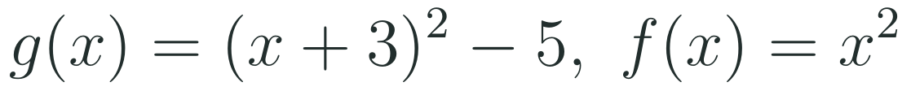
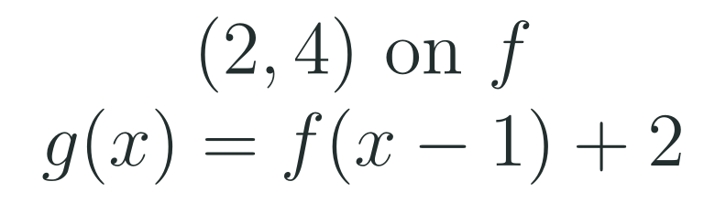
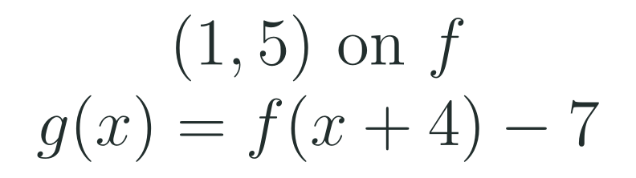
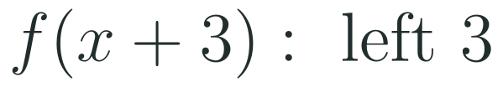

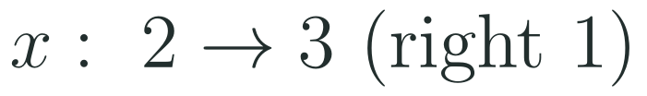
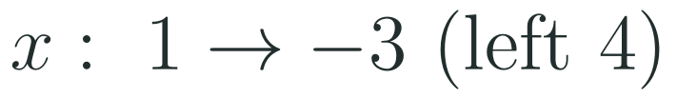
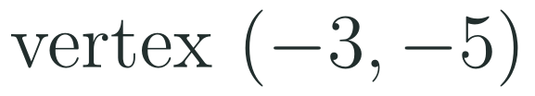
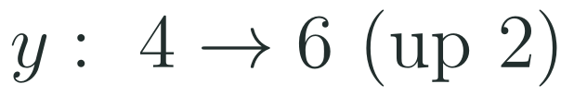
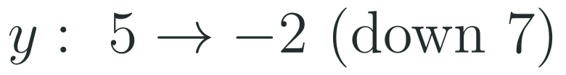
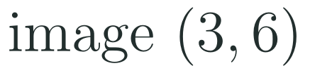
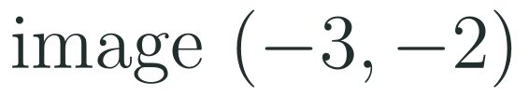
1
2
3
4
5
6
STATION 2 · TARGETED INSTRUCTION · 18 MIN
Additive transformations: translations
EXAMPLE A
EXAMPLE B
EXAMPLE C
LO 1.12.A
FAITH, RIGHTEOUSNESS AND WISDOM
Mr Malek Thiab · 5
Notes:
Speaker notes (Targeted Instruction, block 1 of 3):
Speaker notes (Targeted Instruction, block 1 of 3, LO 1.12.A). EK 1.12.A.1: 'The function g(x) = f(x) + k is an additive transformation of the function f that results in a vertical translation of the graph of f by k units.' EK 1.12.A.2: 'The function g(x) = f(x + h) is an additive transformation of the function f that results in a horizontal translation of the graph of f by -h units.'
Worked solutions: Example A: g(x) = f(x + 3) - 5 with f(x) = x^2; the parent vertex (0, 0) moves left 3 and down 5 to (-3, -5). Example B: g(x) = f(x - 1) + 2 means h = -1, so a shift right 1; (2, 4) becomes (3, 6). Example C: h = 4 so shift left 4; k = -7; (1, 5) becomes (-3, -2).
Verbal misconceptions: 'x + 3 moves the graph right because it is positive'; 'the horizontal shift is h, not -h'.
Adaptive routing: if more than 30% miss Gate Q1, return to this slide and redo Example A aloud.

Slide 6

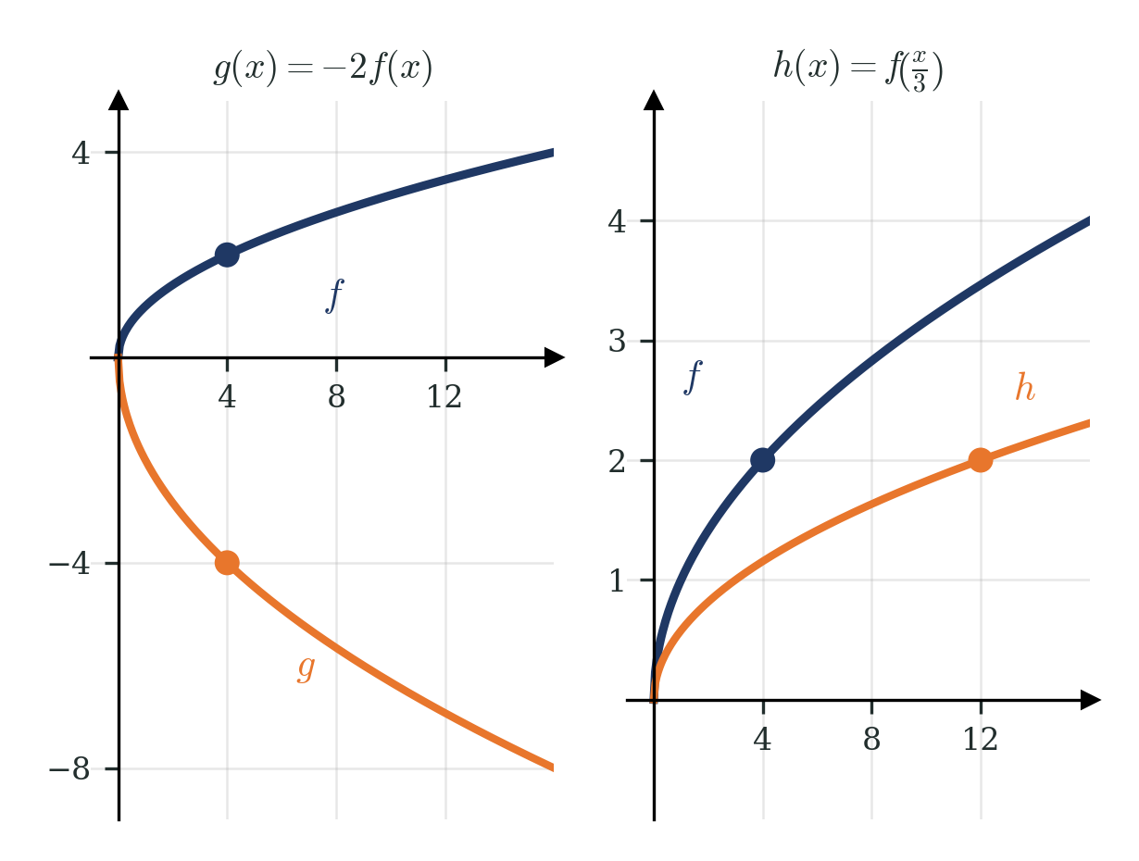
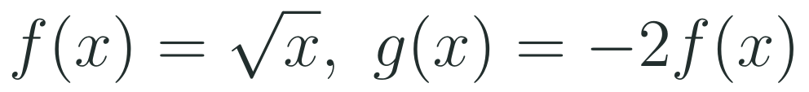
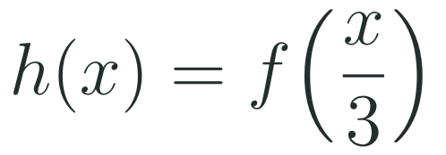
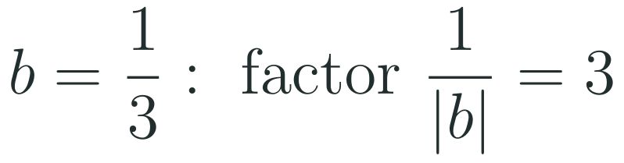
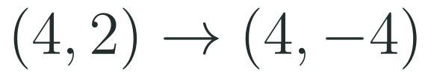
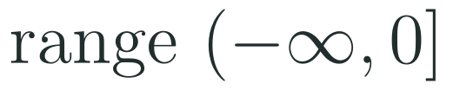
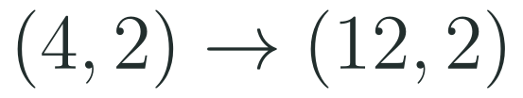
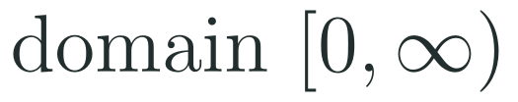
1
2
3
4
5
6
STATION 2 · TARGETED INSTRUCTION · 18 MIN
Multiplicative transformations: dilations
EXAMPLE A
EXAMPLE B
LO 1.12.A
FAITH, RIGHTEOUSNESS AND WISDOM
Mr Malek Thiab · 6
Notes:
Speaker notes (Targeted Instruction, block 2 of 3):
Speaker notes (Targeted Instruction, block 2 of 3, LO 1.12.A). EK 1.12.A.3 and 1.12.A.4 (the dilation factors were garbled in the fetched text and are reconstructed in standard form; check against the CED PDF): g(x) = a f(x), a not 0, gives a vertical dilation by a factor of |a| with a reflection over the x-axis if a < 0; g(x) = f(bx), b not 0, gives a horizontal dilation by a factor of 1/|b| with a reflection over the y-axis if b < 0.
Worked solutions: Example A: f(x) = sqrt(x) passes through (4, 2). With a = -2 every y-value is multiplied by -2: (4, -4). The outputs of f are 0 or more, so the outputs of g are 0 or less: range (-infinity, 0]. Example B: b = 1/3 so every x-value is multiplied by 1/|b| = 3: (4, 2) goes to (12, 2). Check: h(12) = sqrt(12/3) = 2. The domain stays [0, infinity).
Verbal misconceptions: 'f(x/3) squeezes the graph by 3' (it stretches horizontally by 3); 'a negative a only changes the dilation'; 'multiply the x-coordinate by b'.
Adaptive routing: if more than 30% miss Gate Q2, return to this slide and trace the point (4, 2) on both panels.

Slide 7

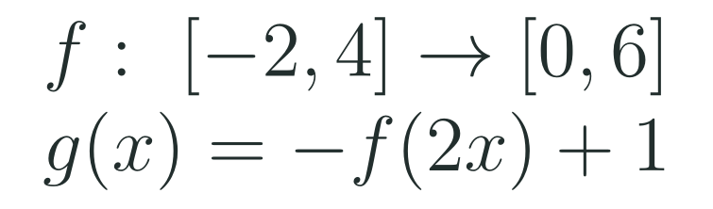
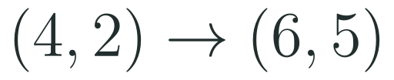
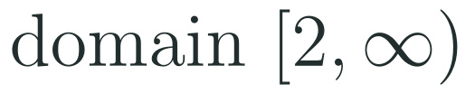
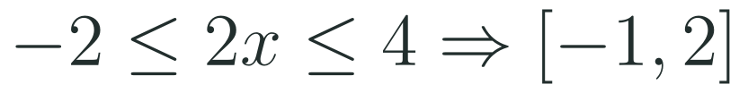
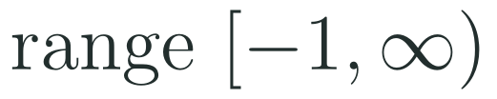

1
2
3
4
5
6
STATION 2 · TARGETED INSTRUCTION · 18 MIN
Combined transformations, domain and range
EXAMPLE A
EXAMPLE B
LO 1.12.A
FAITH, RIGHTEOUSNESS AND WISDOM
Mr Malek Thiab · 7
Notes:
Speaker notes (Targeted Instruction, block 3 of 3):
Speaker notes (Targeted Instruction, block 3 of 3, LO 1.12.A). EK 1.12.A.5: 'Additive and multiplicative transformations can be combined, resulting in combinations of horizontal and vertical translations and dilations. The set of points prior to the transformations is called the preimage of the transformations, and the set of points after the transformations is called the image of the transformations.' EK 1.12.A.6: 'The domain and range of a function that is a transformation of a parent function may be different from those of the parent function.'
Worked solutions: Example A: g(4 + 2) = 3 f(4) - 1 = 3(2) - 1 = 5, so the image of (4, 2) is (6, 5). Domain: x - 2 >= 0 gives [2, infinity). Range: 3 sqrt(.) >= 0, minus 1 gives [-1, infinity). Example B: g(x) is defined when 2x is in [-2, 4], so x is in [-1, 2]. The outputs of f lie in [0, 6]; negating gives [-6, 0]; adding 1 gives [-5, 1].
Verbal misconceptions: 'the domain of f(2x) is [-4, 8]' (it is divided by 2, not multiplied); 'the +1 is applied before the negation'.
Adaptive routing: if more than 30% miss Gate Q3, return to this slide and redo Example B on a number line.

Slide 8
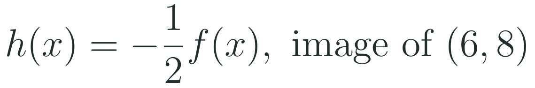
1
2
3
4
5
6
STATION 3 · PRACTICE · 12 MIN
Give it a go: Practice, Apply, Investigate
PRACTICE
APPLY
INVESTIGATE
Secure the method
Use it in context
Find out why
Done when: you state the shift in each direction and write the image point.
Done when: you name the dilation factor and the reflection, and write the image point.
Done when: your explanation uses a specific input value that gives the same output as before.
LO 1.12.A
FAITH, RIGHTEOUSNESS AND WISDOM
Mr Malek Thiab · 8
Notes:
Speaker notes (Practice, 12 min; tierless differentiation: students choose the starting column and may move across):
Speaker notes (Practice, 12 min; tierless: students choose the starting column and may move across).
Answers: Practice: left 3 and down 4: (-2, 5) becomes (-5, 1). Apply: vertical dilation by 1/2 and reflection over the x-axis: (6, 8) becomes (6, -4). Investigate: g(x) = f(x + 3) takes the same output at x = a - 3 that f takes at x = a, so each point moves 3 units left.
Verbal misconceptions: 'plus means right'.
Adaptive routing: finished students move to Apply then Investigate; stuck students return to slide 6.

Slide 9
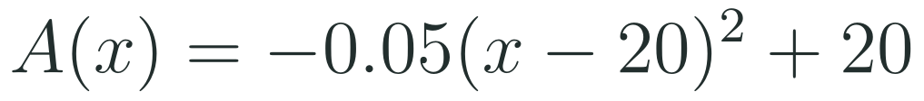

1
2
3
4
5
6
STATION 4 · PRODUCTION · 12 MIN
Production: the arch of a footbridge
THE MODEL
DONE WHEN
The arch of a footbridge is built from the parent function x squared by transformations. The model gives the height in metres of the arch above the water at a horizontal distance x metres from the left bank. The numbers are model values for practice, not a real bridge.
Each transformation names its direction or factor.
The greatest height is given with the value of x.
Both distances are given to two decimal places.
Every answer includes units (metres).
Describe, in order, the transformations of the parent function x squared that give the arch.
Find the greatest height of the arch and the height 10 metres from the left bank.
Find the horizontal distances at which the arch is 12 metres high.
Hint: set the height equal to 12 and isolate the squared bracket first.
LO 1.12.A
FAITH, RIGHTEOUSNESS AND WISDOM
Mr Malek Thiab · 9
Notes:
Speaker notes (Production, 12 min):
Speaker notes (Production, 12 min).
Solutions: Task 1: shift right 20, vertical dilation by 0.05, reflection over the x-axis, shift up 20. Task 2: the vertex is (20, 20): greatest height 20 m at x = 20; A(10) = -0.05(100) + 20 = 15 m. Task 3: -0.05(x - 20)^2 + 20 = 12 gives (x - 20)^2 = 160, so x = 20 +/- 12.649, i.e. x = 7.35 m and x = 32.65 m. A(0) = A(40) = 0, so the range on the domain is [0, 20].
Verbal misconceptions: 'x - 20 moves the arch left'; losing the second solution of the square root.
Adaptive routing: if students cannot start, send them to slide 5 Example A and the hint.

Slide 10
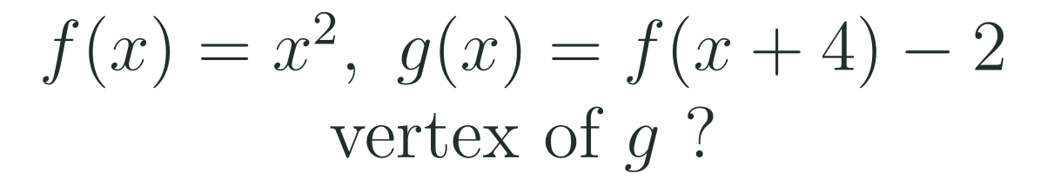
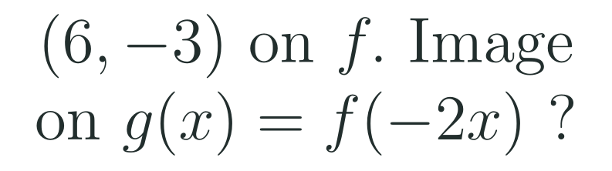
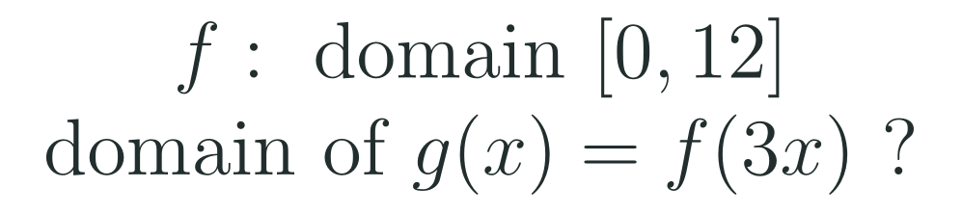
1
2
3
4
5
6
STATION 5 · MASTERY GATE · 6 MIN
Mastery Gate: three questions to pass
1
2
3
Pass mark
3 of 3 correct unlocks Station 6. Fewer than that: return to the slide for the question you missed, redo it, then re-take the gate.
LO 1.12.A
FAITH, RIGHTEOUSNESS AND WISDOM
Mr Malek Thiab · 10
Notes:
Speaker notes (Mastery Gate, 6 min, no calculator):
Speaker notes (Mastery Gate, 6 min, no calculator).
Answers: Q1 (-4, -2). Q2 b = -2: x becomes 6/(-2) = -3, y unchanged: (-3, -3) (dilation by 1/2 and reflection over the y-axis). Q3 0 <= 3x <= 12 gives [0, 4].
Verbal misconceptions: Q1 '(4, -2)'; Q2 'multiply x by -2 to get (-12, -3)'; Q3 'multiply the domain by 3 to get [0, 36]'.
Adaptive routing: Q1 missed, route to slide 5 Example A; Q2 missed, route to slide 6 Example B; Q3 missed, route to slide 7 Example B.

Slide 11
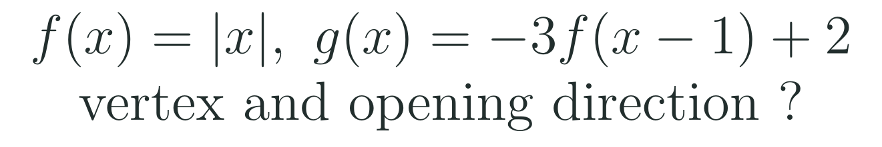
1
2
3
4
5
6
STATION 6 · SMART PRODUCTION · 6 MIN
Smart Production: make one, then check it
CREATE
TIME TO CHECK
Choose a parent function and write g(x) with one translation, one dilation and one reflection.
On the back, write the image of one point of your choice.
Swap with a partner: they name each transformation in order and check your image point.
Exit ticket: write your answer on a sticky note and place it on the door.
Done when: your partner confirms every transformation and the image point.
Next lesson: Topic 1.13 Function Model Selection and Assumption Articulation.
LO 1.12.A
FAITH, RIGHTEOUSNESS AND WISDOM
Mr Malek Thiab · 11
Notes:
Speaker notes (Smart Production, 6 min):
Speaker notes (Smart Production, 6 min).
Exit answer: the vertex of |x| moves right 1 and up 2 to (1, 2); a = -3 reflects over the x-axis, so the graph opens downward and is steeper (slopes of -3 and 3 on each side, with the outputs reflected).
Verbal misconceptions: students give (-1, 2) or say it opens upward. Ask: which number is inside the function?

Slide 12
Journey complete
Targeted Instruction
Production
Smart Production
✓
✓
✓
✓
✓
✓
Diagnose
Practice
Mastery Gate
Inside changes move and stretch the graph horizontally in the opposite sense, outside changes act vertically, and domain and range can change.
FAITH, RIGHTEOUSNESS AND WISDOM
Notes:
Speaker notes: Every station is checked off. Recap in one sentence: Inside changes move and stretch the graph horizontally in the opposite sense, outside changes act vertically, and domain and range can change. Collect the Time to Check responses. Next lesson: Topic 1.13 Function Model Selection and Assumption Articulation.

